Slide 1

CamBoard
The solution to a fire-safe home

Slide 2

We want to live in an exciting future

Slide 3

Reality

Slide 4
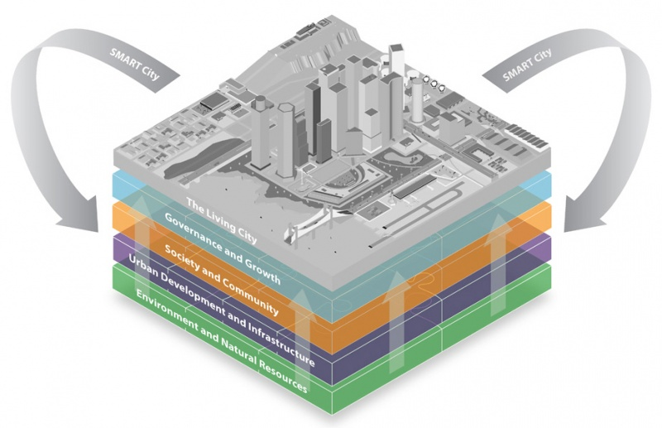
Smart Cities

Slide 5
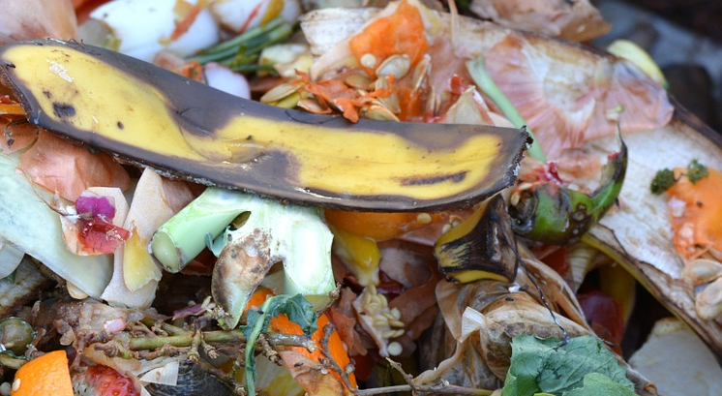
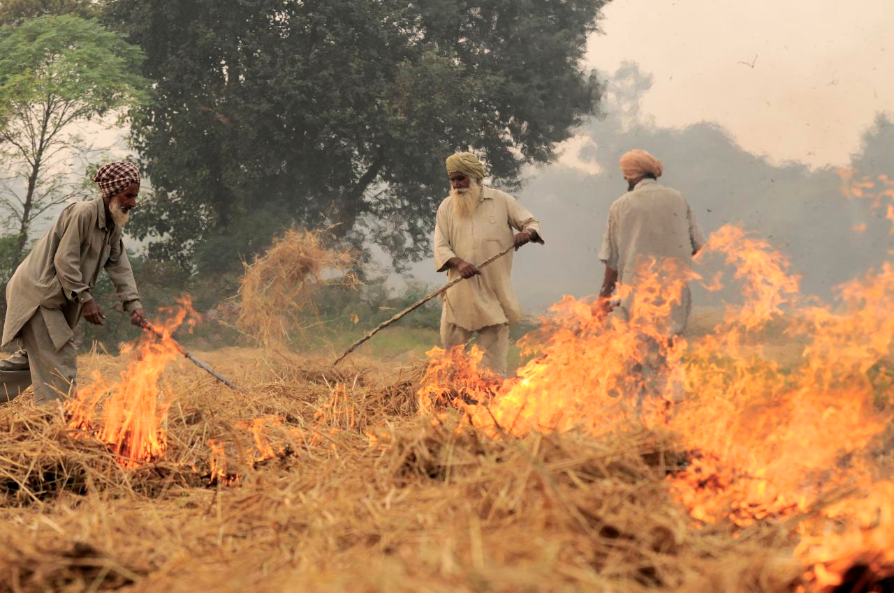
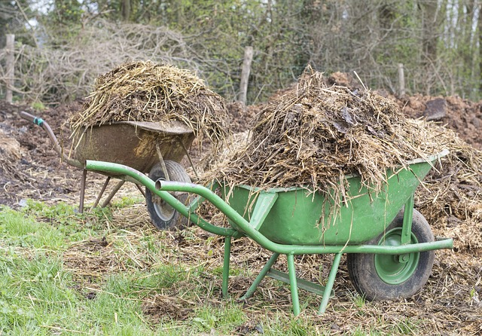
Agriculture produces more than
2 Billion tonnes of waste biomass
Lack of popular cost efficient way to use these resources

Slide 6

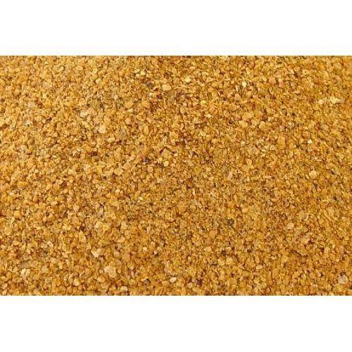
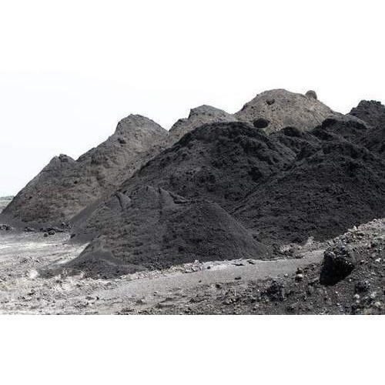
Commercialising waste
Biomass
Distillers Dried Grains and Solubles
Fly Ash
Low temperature firing process
Biocomposite fire resistant board

Slide 7






Fire Resistant
Low on harmful chemicals
Biodegradable
CamBoard
Lower CO₂ footprint
Lower cost of manufacturing
Patent protected

Slide 8
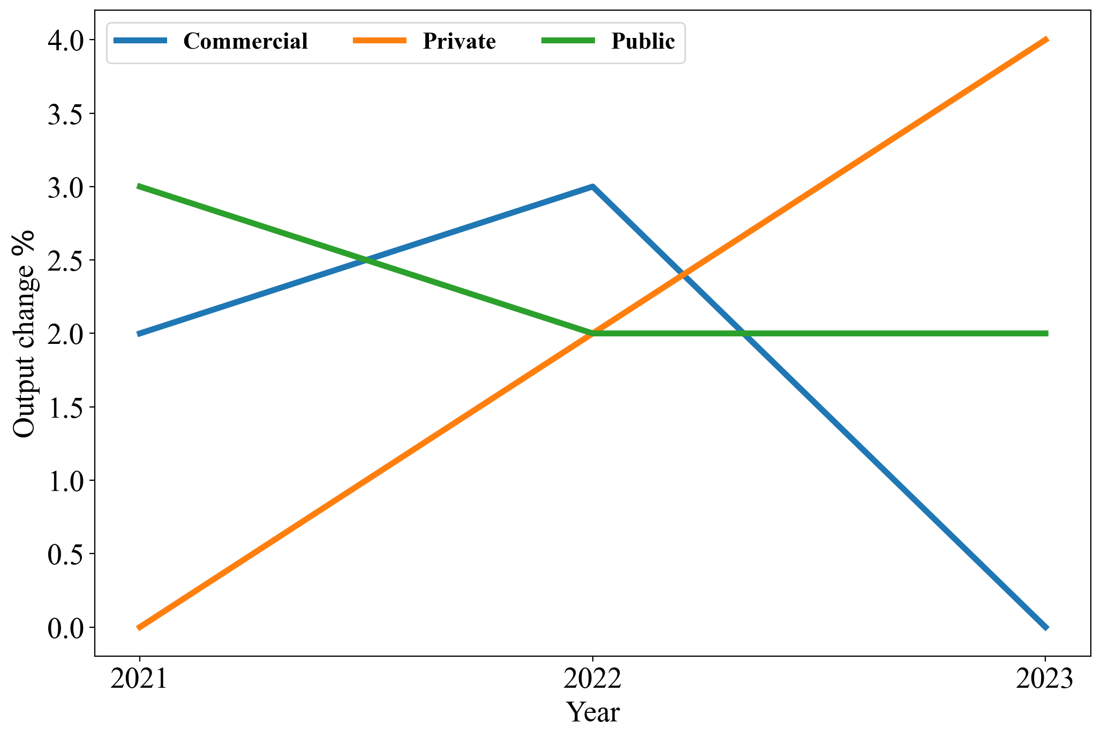
Construction sector is driven by a huge demand for residential housing
Private housing fastest increase
Growth of the plasterboard market

Slide 9
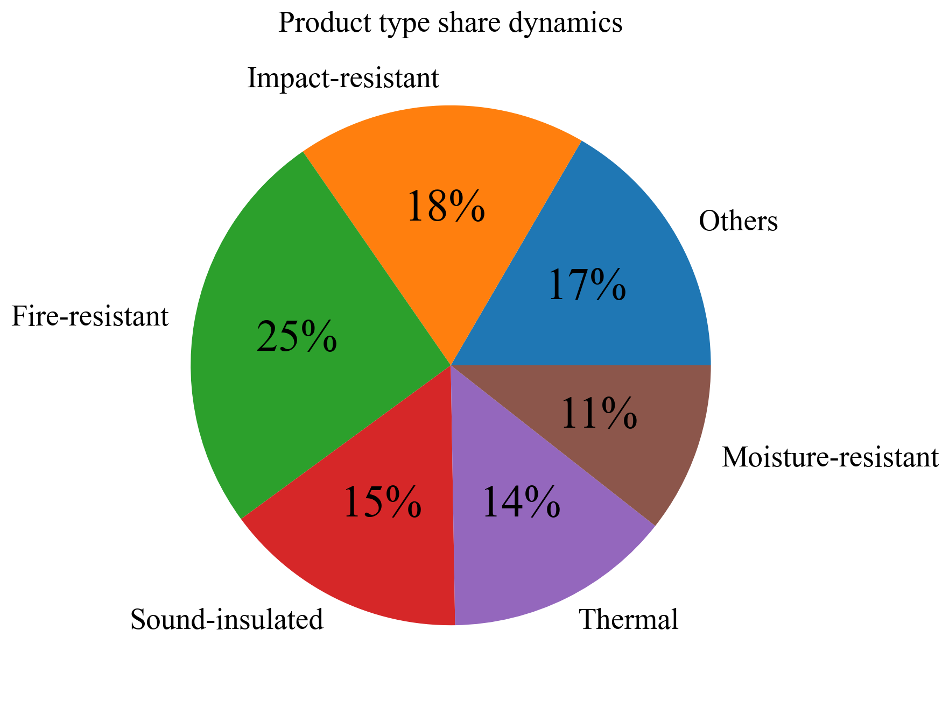
Globally, Fire resistant boards projected to be the highest in demand
Class B plasterboards ones are the most used in residential housing

Slide 10
Market Traction
Safe
83%
88%
Desired
features
Durable
Economical
respondents concerned about harmful chemicals in existing flame-resistant flatboards
respondents willing to try out Cambond’s environmentally sustainable flatboard
Source: Primary research of 160+ survey respondents and interviews with industry experts

Slide 11
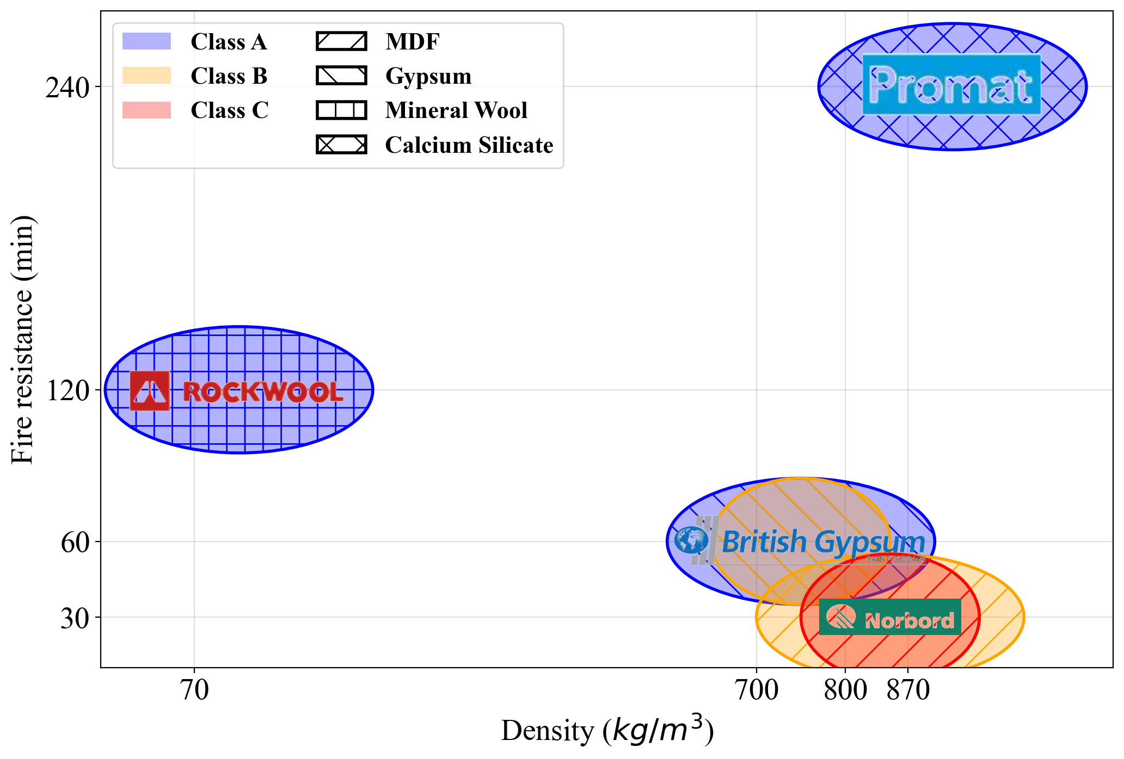
No toxic coatings
CamBoard
Camboard Class B expected to be around here
We estimate Camboard final price to be lower than the average, with a cost of production of £3.50.

Slide 12


Route to market
Licence
technology
Partners

Slide 13





The Team
Dr Gareth Roberts and Prof Xiabin Zhao
The Inventors
Akhila Jayaram
The Director
Spyros Ploussiou
The Analyst
Omar Darwish
The Artist
Elena Gelzinyte
The Influencer

Slide 14



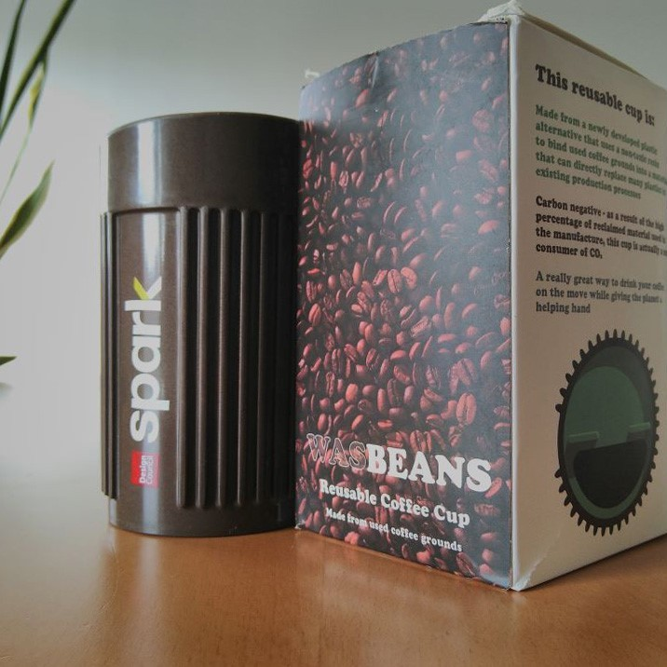

Innovate UK grant for utilisation of waste streams
Patents filed and granted
2020
2021-Beyond
2016-19
2020
First products with bioresin
Industrial demonstration and revenue generation

Slide 15
Circular economy: this is an exciting future!
Waste Management
Low Carbon Goods replace existing ones
Boards
Goods Made
Supply Chain

